Slide 1

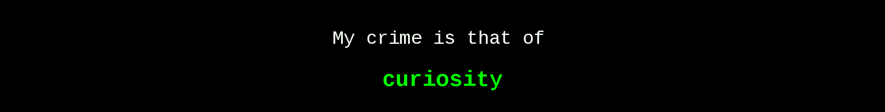
Practical
Reviews – 1b

Slide 2
Practical 1b
Network Protocols
LEARNING OUTCOMES – Topic 1a-b
At the end of these practicals, you will be able to :
Analyse network traffic using wireshark.
Explain the purpose of common network protocols.
Identify the ports used by common network protocols.
Apply various offensive security techniques on network services.

Slide 3
Review Practical 1b
EXERCISE 1
Exercise 1
Using Remote Desktop to Connect to a Remote System
Demonstrate that Remote Desktop Protocol is encrypted.

Slide 4
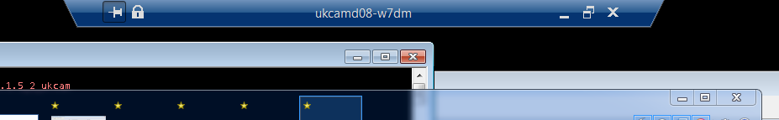
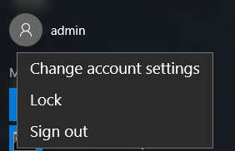
Review Practical 1a
EXERCISE 5
Q: Is there a difference between crossing out a session, and signing out a session?
Tips:
RDP into the Win10 and open a Calculator program.
Then exit the session by crossing out. Log back in again.
Does the Calculator remain open?
Now exit the session by signing out. Log back in again.
Does the Calculator remain open?
Check this out
https://docs.vmware.com/en/VMware-Horizon-Client-for-Windows/5.5/horizon-client-windows-user/GUID-5378232D-008C-47DC-8B61-4F44947C0419.html

Slide 5
Review Practical 1b
EXERCISE 2
Exercise 2
Address Resolution Protocol (ARP) Spoofing
Demonstrate 2 ways of installing arpspoof utility in Kali Linux.
Demonstrate ARP MITM attack with arpspoof utility.

Slide 6
Review Practical 1b
EXERCISE 2
Q: Who is/are the bad guy/s and victim/s in this exercise?
Q: Which layer in the OSI model does ARP operate in?
REMEMBER: ARP deals with MAC address only.
Diagram depicting correlation between ARP and MAC Address Table.
Diagram depicting correlation of MAC Address Tables between switches.
Check this out
https://www.practicalnetworking.net/series/packet-traveling/host-to-host-through-a-switch/

Slide 7
Review Practical 1b
EXERCISE 3
Exercise 3
Bettercap, ARP, DNS Spoof and SSL Strip
Demonstrate network reconnaissance with BetterCap.
Demonstrate MITM attack on ARP with BetterCap.
Demonstrate MITM attack on DNS with BetterCap.
Demonstrate MITM attack on SSL with BetterCap.

Slide 8
Review Practical 1b
EXERCISE 3
Q: Which layer in the OSI model does DNS operate in?
REMEMBER: DNS deals with names, and only humans read names.
Q: Who is/are the bad guy/s and victim/s in this exercise?
Q: In the exercise, does both arp.spoof and dns.spoof modules need to be running concurrently in order to conduct DNS poisoning?
Why?
Tips: Observe the relationship formed between the victim and the bad guy/s in order to get the victim to conned.
Check this out
https://www.bettercap.org/modules/ethernet/spoofers/

Slide 9
Review Practical 1b
EXERCISE 5
Exercise 5
DNSCHef
Demonstrate DNS proxying with DNSChef.

Slide 10
Review Practical 1b
EXERCISE 5
Q: What is the difference in the victim’s IP addressing setup between Ex 3 and Ex 5?
Tips:
Ex 3 describes MITM attack on DNS by hijacking the victim’s DNS request traffic.
Ex 5 describes MITM attack on DNS by providing a legit DNS proxy service to the victim.
In both cases, the victim is redirected to a different webpage.
Q: Does DNS redirection still works if the following values in the DNSChef command is changed?
Original
sudo dnschef -i KaliIP –fakedomains kali.org,kali.org.localdomain --fakeip KaliIP --nameservers CurrentDNS-IP
Changed
sudo dnschef -i KaliIP –fakedomains google.com,www.google.com --fakeip WebserverIP --nameservers CurrentDNS-IP
Try… Check this out https://www.kali.org/tools/dnschef/

Slide 11
Review Practical 1b
EXERCISE 6
Exercise 6
Ping Sweep
Demonstrate ping sweep with fping utility on Linux.
Demonstrate sending custom TCP packets with hping3 utility on Linux.
Exercise 7
Basic Port Scans
Demonstrate port scanning with Nmap utility on Linux.
Q: Can AngryIP Scanner also be used for the same purpose as Nmap on Windows?

Slide 12


